Slide 1

Is there a Global Warming?
Ironhhack Mid Bootcamp Project
João Cabral
Notes:
The goal of this project is to explore Global and Local temperature measures during a certain time period.
For local temperature exploration I am focusing in Portugal
As a side objective. I intend to raise awarness about global warming and suggest good daily practices that can help mitigate world heating.

Slide 2
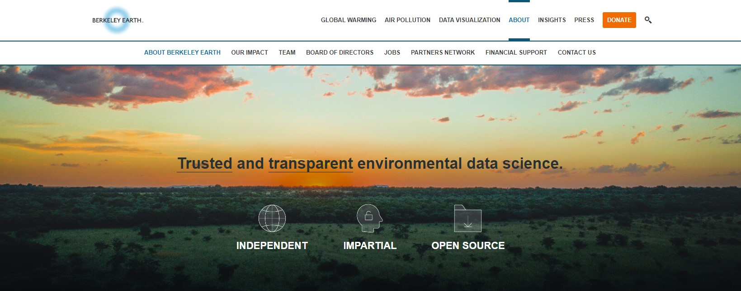
Dataset
Notes:
The Dataset contain Global temperature measures starting in 1750 until 2015.
The data was updated by Berkeley Earth, which is a non-profit organization focused on environmental science.
This case study has 1.6 billion temperature reports from 16 pre-existing files, so great work on their side!

Slide 3
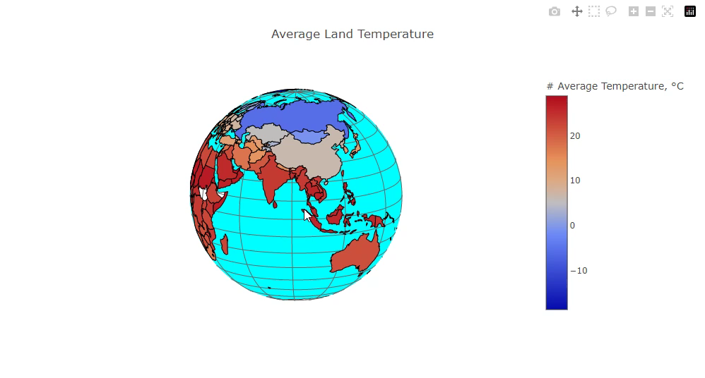
Notes:
Informational Plot.
This is na interactive plot where user can check the average temperature for each country.
You can go around the Globe searching for country of interest.

Slide 4
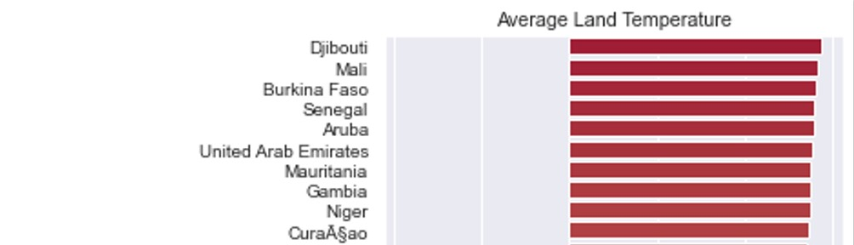
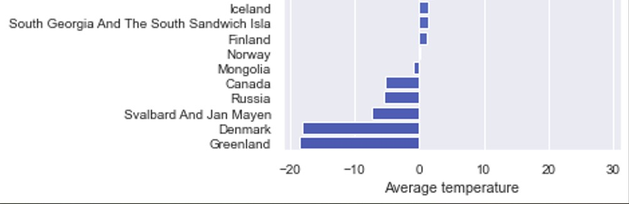
Notes:
The code for this plot retieves average temperature for ALL country’s.
This way we can easily identify which country is the hottest and which one is the coldest.
I only placed here the top 10 of each extreme temperature, because it was too big.

Slide 5
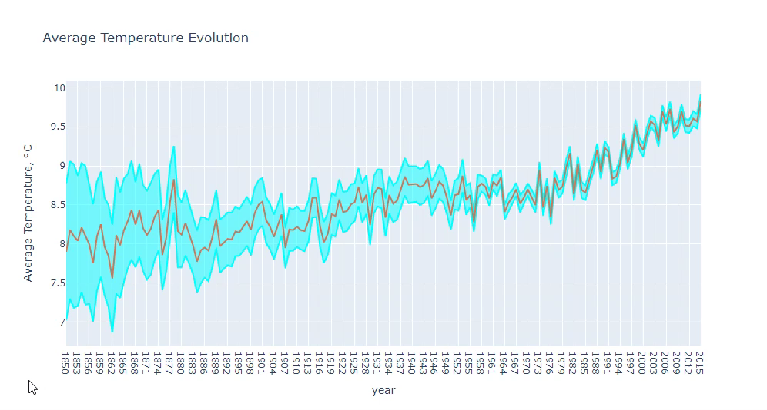
Notes:
In this plot we can clearly identify an overall rise in temperature through out the years.
Take special attention to the late 19’s (67) where we can see that temperature is going over the roof
The light blue limits are the uncertainty levels.
You can see that in the beginning of the temperature measures technology wasn’t that reliable.
In the late 19’s electronic thermometers were introduced, this has a big influence in dropping the uncertainty levels.

Slide 6
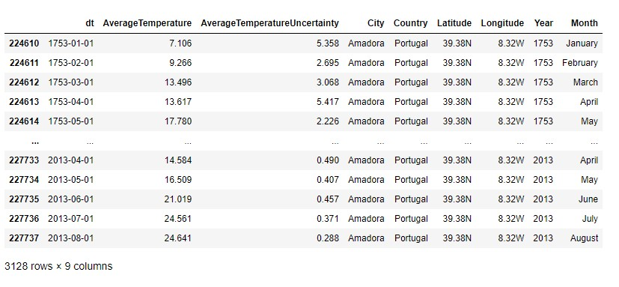
Portugal
Notes:
Now let’s focus in Portugal temperature variation and compare it with global variations.
Here I intend to verify if Portugal is side by side with the world average temperature values.
Portugal temperature was only measured in Amadora, which is a city included in the “Big Lisbon” area.
Therefore, I will use Amadora as a reference for the whole country.

Slide 7
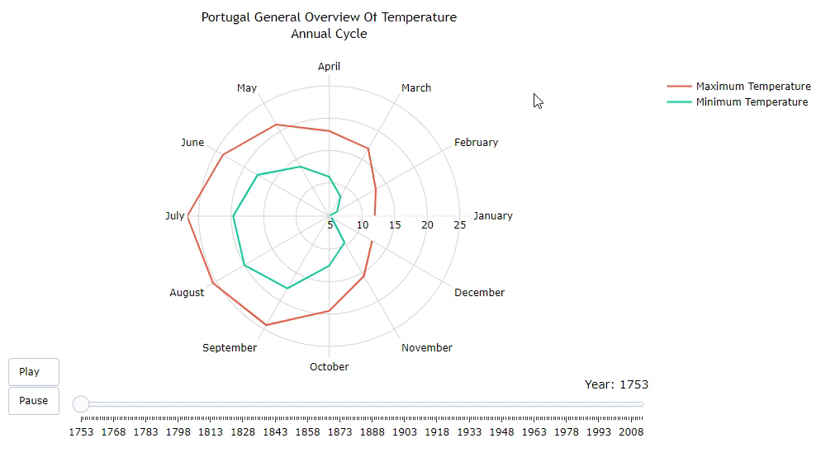
Notes:
This is also an interactive plot.
Displays the avg maximum and avg minimum for each MONTH in the whole period.
When you press play it runs the avg temperature BETWEEN min and max for each year.
You can zoom in to a specific region of the plot and rotate the calendar to your best prefference.
((( r – Correlation Coefficient = covariance divided by individual standard deviation. it’s a normalized measurement of how the two are linearly related. sigma – Standard deviation )))

Slide 8
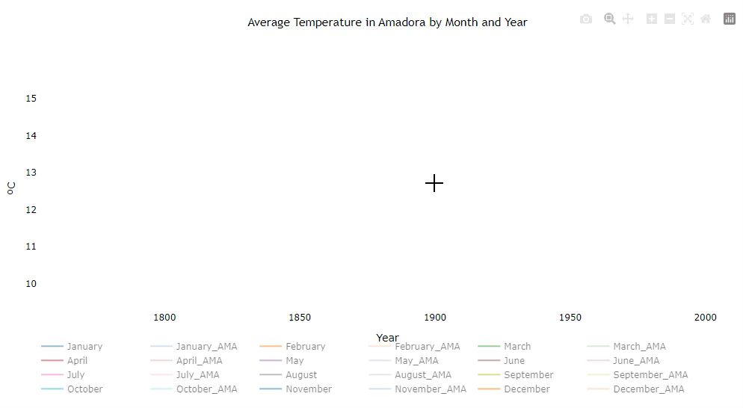
Notes:
Global vs Portugal
Here you can select the months which you would like to have displayed on the plot.
I will choose April as reference month for gobal temperature variation and use April_AMA to display Portugal variations.
When you only select April it shows world’s temperature fluctuation for that month during the years of study.

Slide 9
Thank you!
Notes:
Plots were created with Plotly and it was very fun!

